Slide 1


UTeM Taekwondo Attendance System
Supervisor Name : Dr. Sazalinsyah Bin Razali
Evaluator Name : Dr. Noor Fazilla Binti Abd Yusof
By:
Thitthima a/p Wat

Slide 2
Project Background
Consists of two types of users :
Admins
Students
Target user :
UTeM Taekwondo Club member

Slide 3
Objective
i.To design and develop a centralize attendance system.
ii.To help Taekwondo Master calculate the fees for each student based on their attendance.
iii.To generate a report for every month.

Slide 4
Scope
Module to be developed
Admin
Access to this system to do:
Login,Register,Search,Update,Add,Delete,View,Logout
a.Log in to the system
b.Register for the new user
c.Manage student records
d.Taking attendance
e.Taking fees
f.Update personal details
g.View report

Slide 5
Student
Access to the system to do:
Registration,Login,Update,View,Logout
a.Register for first log in
b.Log in to the system
c.Check fees
d.Update personal details

Slide 6
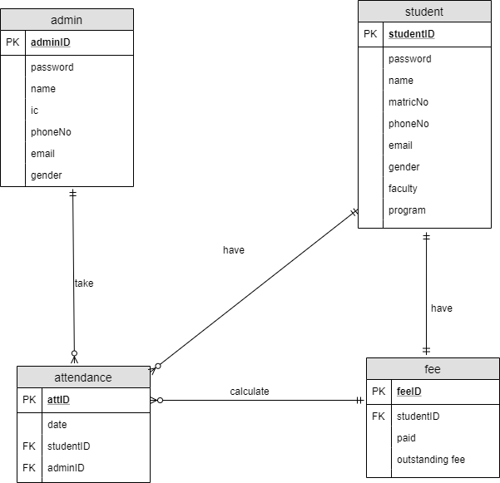
ERD

Slide 7
Business Rules
One adminID can takes many attendances.
One attendance can be taken by only one adminID.
One attID can only have one studentID.
One studentID can have many attID.
One studentID can have only one feeID.
One feeID can have only one studentID.
One feeID can represent only one attID
One attID is represented by one feeID

Slide 8
Data Dictionary
Table Name | Attribute Name | Content | Type | Required | PK/FK | FK Reference Table
admin | adminID password name IC phoneNo email gender | username for adminLogin password Admin name Admin IC number Admin Phone number Admin email Admin gender | VARCHAR VARCHAR VARCHAR INT VARCHAR VARCHAR VARCHAR | YES YES YES YES YES YES YES | PK
student | studentID password Name matricNo phoneNo email gender faculty program | username for student Login password Student name Student Matric Number Student phone number Student Email Student Gender Student faculty Student Program | VARCHAR VARCHAR VARCHAR VARCHAR VARCHAR VARCHAR VARCHAR VARCHAR VARCHAR | YES YES YES YES YES YES YES YES YES | PK
Attendance | attID Date adminID studentID | ID for attendance Training date adminID studentID | VARCHAR DATE VARCHAR VARCHAR | YES YES YES YES | PK FK FK | AdminStudent
fee | feeID paid outstanding studentID | Receipt Number Amount that student already pay Balance that student need to pay ID for Student | INT INT INT VARCHAR | YES YES YES YES | PK FK | Student

Slide 9
Testing
Testing on 22 people and get their feedback
Link for Google form:
https://forms.gle/DV6NEdxeMLGkZKFu7

Slide 10
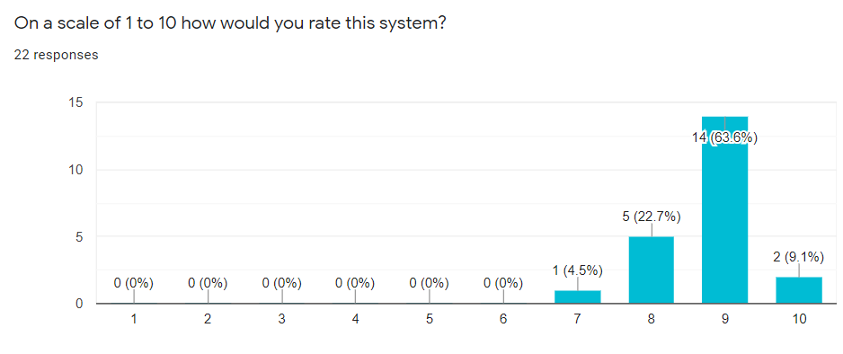
Rate

Slide 11
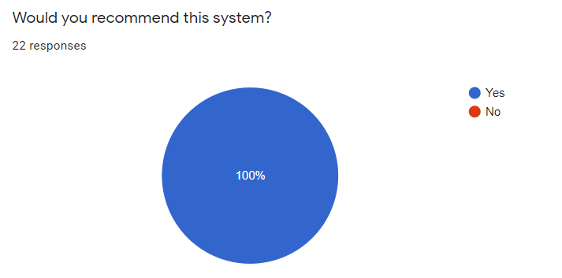
Recommendation

Slide 12
Feedback
add name validation in registration.
the password is can be too short and may not secure
need to have payment history
Login button must combine together
No Validation on registration except for the ID
Need to do checking on name and other details
Print out a receipt on payment and add payment history
Add online fee payment
The interface is simple and nice. The system is very user friendly. Just need to improve on details validation.
Send the email to the student if they didn't pay their fee for at least 3 month

Slide 13
Limitation and Future Improvements
The user interface is too simple.
Student cannot perform the online banking in this system.
No details validation.
No Main Admin
No receipt

Slide 14
THANK YOU

